Slide 1
Programming for graphics
OpenGL / SDL set up and viewports

Slide 2
Get the libraries
SDL: https://www.libsdl.org/download-2.0.php
Download the development libraries
(SDL2-devel-2.0.X-VC.zip)
GLFW: http://glew.sourceforge.net/
Binaries for Windows 32-bit and 64-bit
GLM: https://glm.g-truc.net/0.9.9/index.html
Notes:
Make sure you download the required libraries

Slide 3
Add the libraries to your project
Add the required include folders and lib files for the linker.
We will go over this in the tutorial in detail.

Slide 4
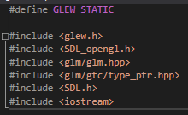
Defines and includes
GLEW_STATIC tells GLEW that we are going to include its code straight into the exe (statically)
Include glew.h first
Glm is the math library
SDL is our window library
Iostream for cout

Slide 5
Initialize SDL
We initialize SDL with SDL_INIT_EVERYTHING so that we can us any feature in SDL that we want, without having to worry about enabling it later on down the line.

Slide 6
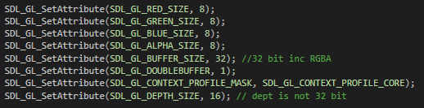
Tell sdl how to setup openGL
First 4 set up bit depth for RGBA
5th tells openGL how many bits per pixel so it can set up the buffer properly.
6th enables double buffering
7th tells openGL we don’t want old, deprecated functionality.
8th sets up our depth buffer bit size (needed for shadow mapping.

Slide 7
Double buffering

Slide 8
V-Sync - Vertical Synchronisation
Forces game to draw and update frames in time with monitor’s refresh rate
e.g. 75Hz refresh rate = 75 frames per second

Slide 9
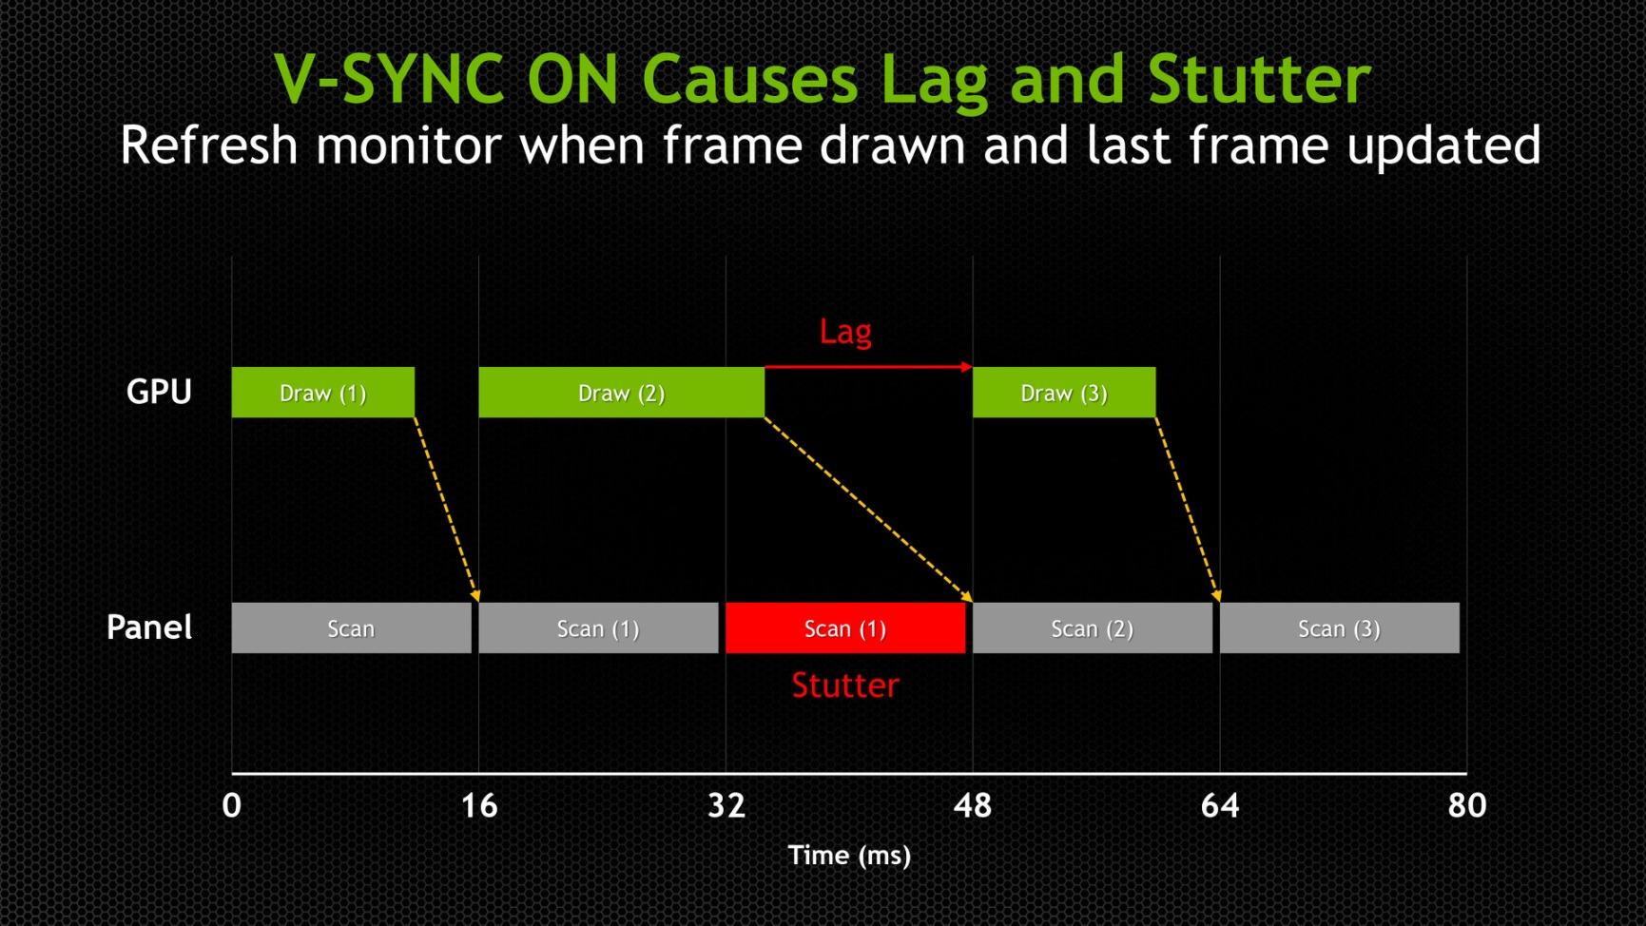
V-Sync
Great! Unless the computer can’t keep up…

Slide 10
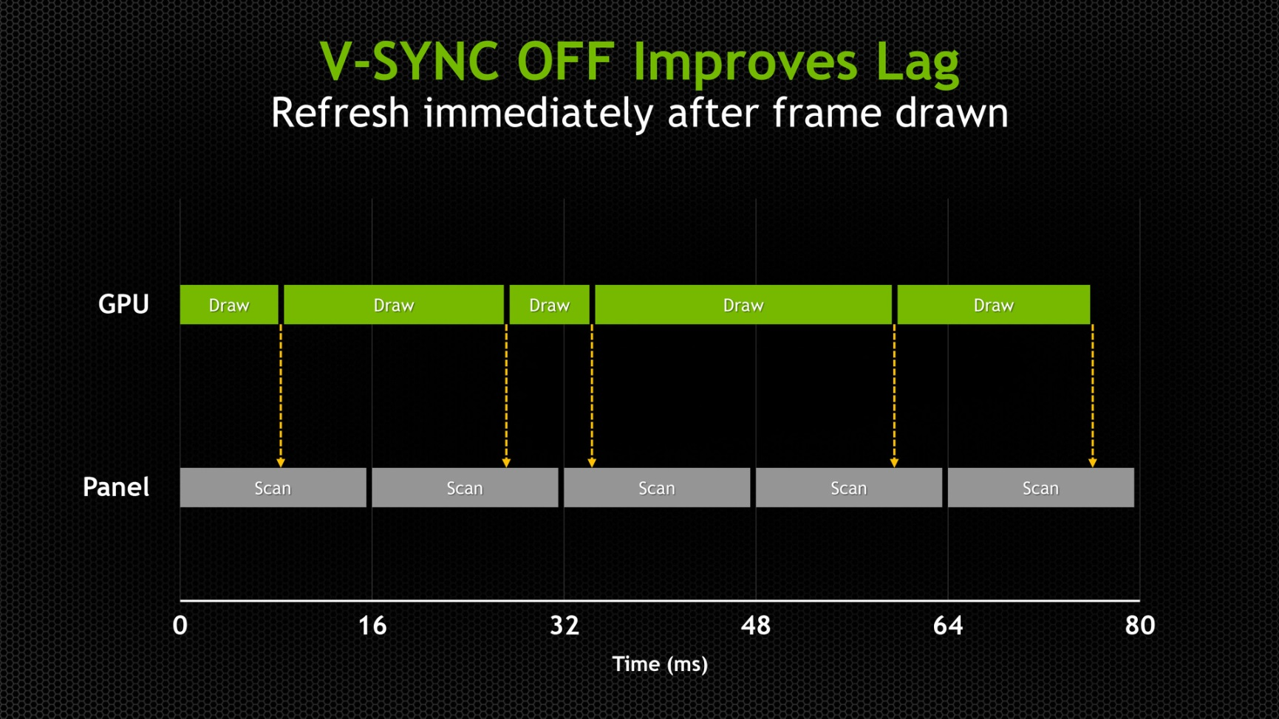
OK, scratch that. No V-Sync, update as soon as the back buffer is ready.

Slide 11
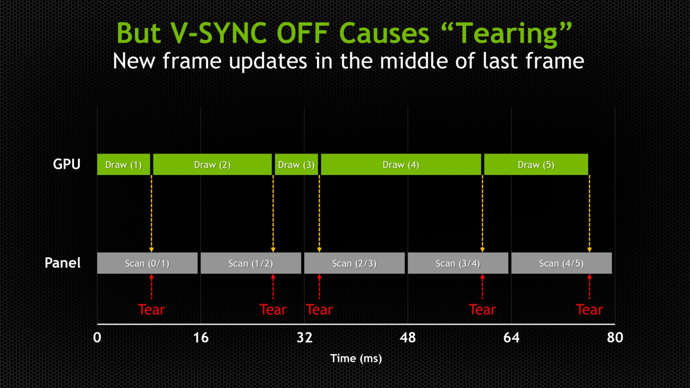
No V-Sync - Better frame rate, responsive game, BUT screen tearing:

Slide 12
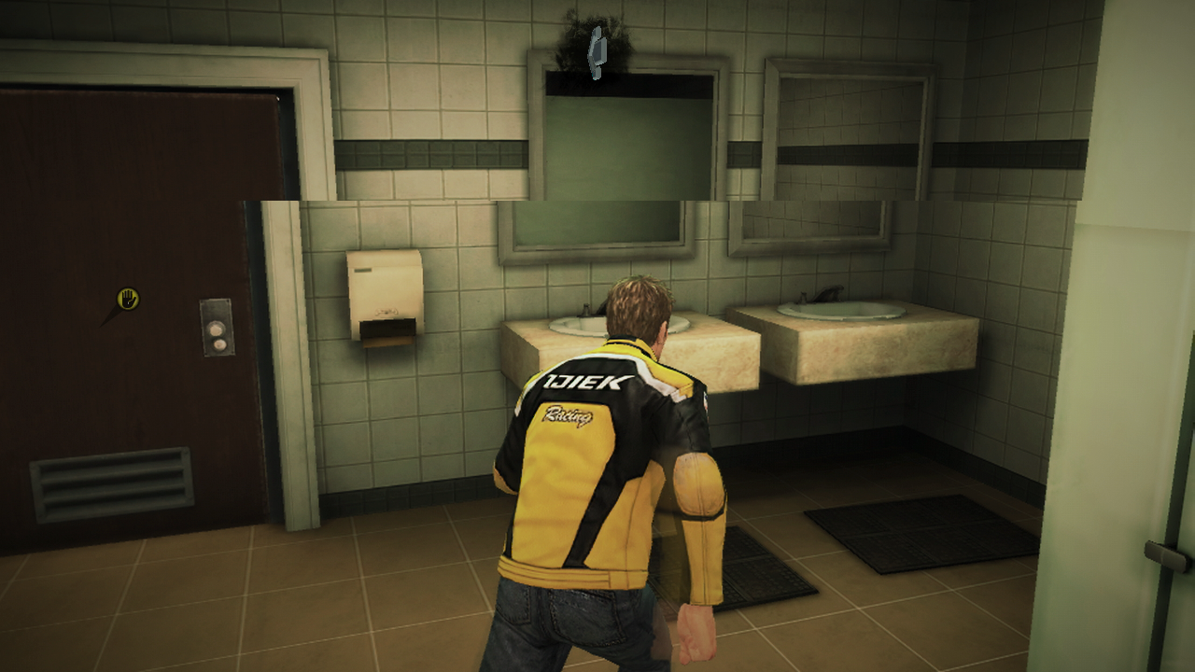
Screen Tearing

Slide 13
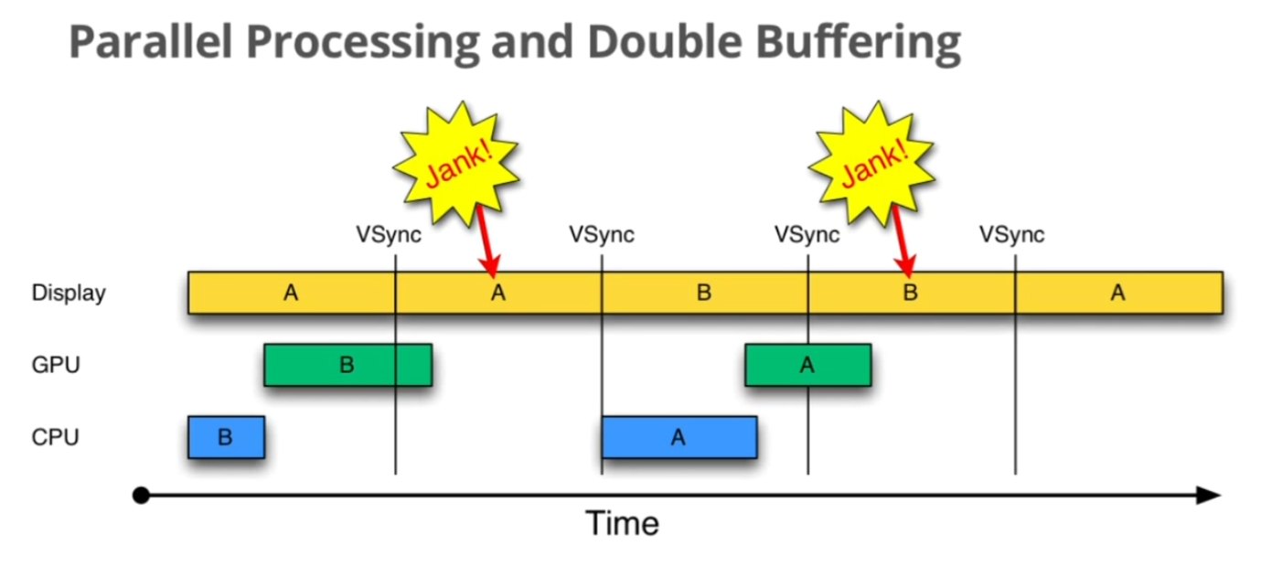
Solutions - Double Buffering (it’s OK)
2 Buffers used: ‘A’ and ‘B’
4) Buffer “A” data
displayed again
(stuttering)
5) Buffer “B” data finally displayed
1) Buffer “A” data drawn to screen
2) On sync update,
buffer “B” data
compiled by CPU
3) Buffer “B” data given to
GPU for assembly, but not
completed in time to display
6) On sync update,
buffer “A” data
compiled by CPU

Slide 14
Solutions?
Triple Buffering
Rather than use the more common double draw buffer solution, use THREE buffers!

Slide 15
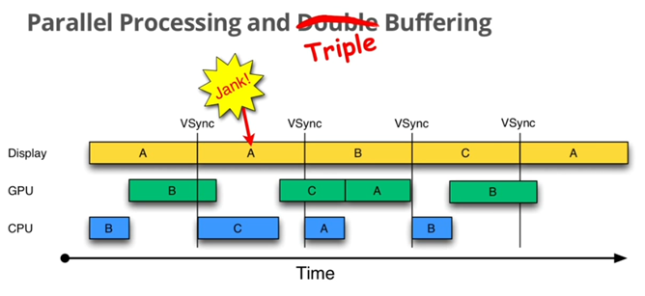
Solutions? - Triple Buffering (it’s better)
3 Buffers used: ‘A’, ‘B’ and ‘C’
4) Buffer “A” data
displayed again
(stuttering)
6) Buffer “C” data given to GPU for assembly
7) Buffer “B” data
displayed
1) Buffer “A” data drawn to screen
9) Buffer “A” data given to GPU for assembly
2) On sync update,
buffer “B” data
compiled by CPU
8) On sync update,
buffer “A” data
compiled by CPU
3) Buffer “B” data given to
GPU for assembly, but not
completed in time to display
5) On sync update,
buffer “C” data
compiled by CPU

Slide 16
Solutions? - Triple Buffering
Pros:
* Less stuttering.
Cons:
* (slightly) more CPU/GPU intensive
* Can cause input lag (because the “next” screen is being prepared more in advance).

Slide 17
Solutions? – Combination of Double and Triple Buffering
Use mostly Double buffering, but keep the third buffer in reserve.
* Minimise unnecessary input lag
* Minimise CPU/GPU load
* Use third buffer when required to minimise screen stutter.

Slide 18
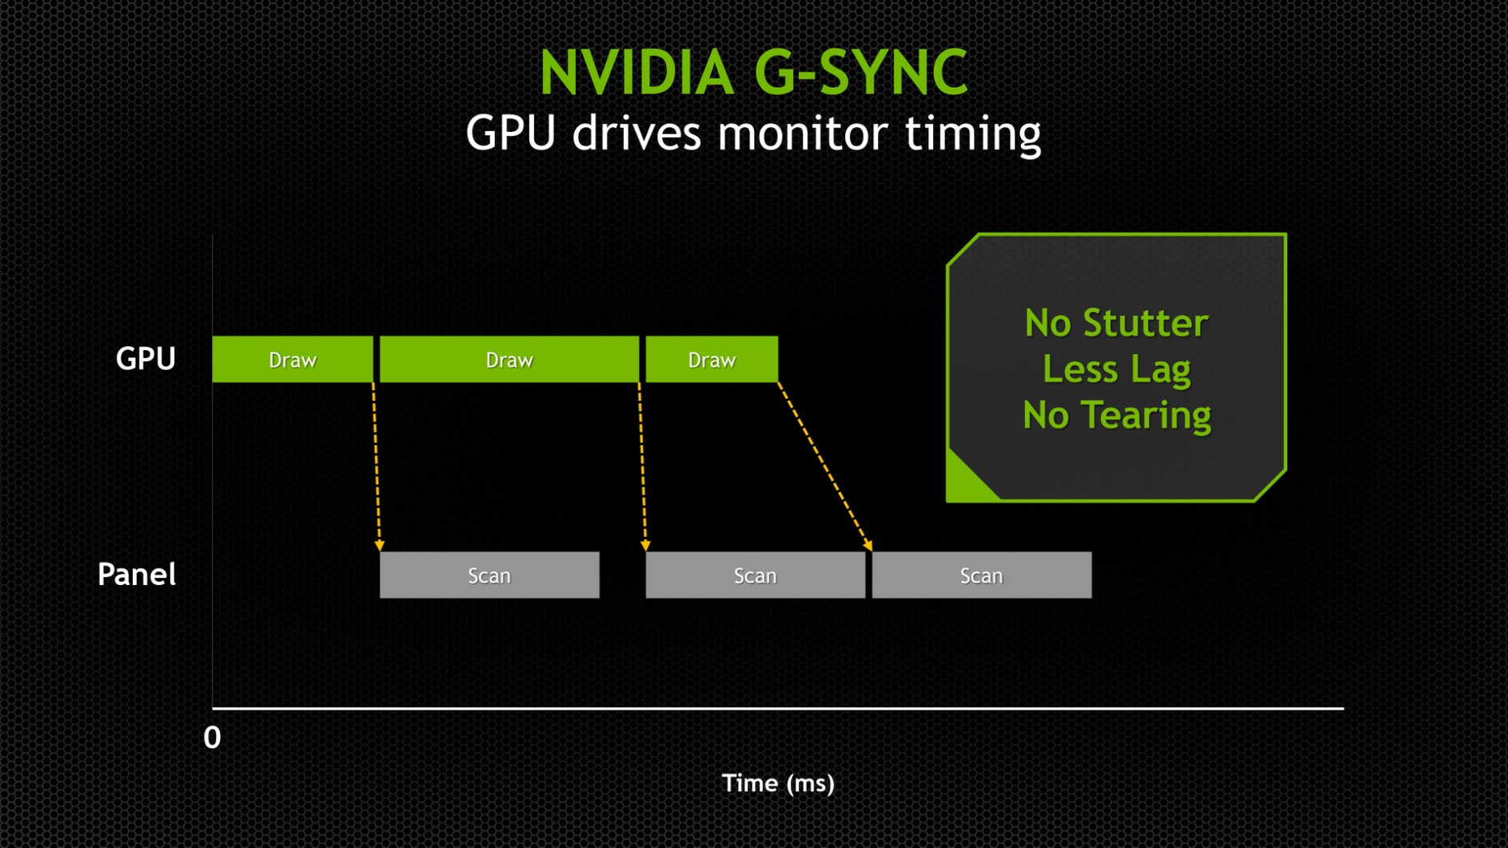
Solutions? – Nvidia’s G-Sync
http://www.eurogamer.net/articles/digitalfoundry-nvidia-g-sync-the-end-of-screen-tear-in-pc-gaming

Slide 19
Create a window and an opengl context

Slide 20

Initialize GLEW and enable depth testing

Slide 21
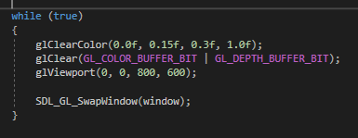
Create an infinite loop, clear the screen and present the result

Slide 22

Clean up

